Slide 1
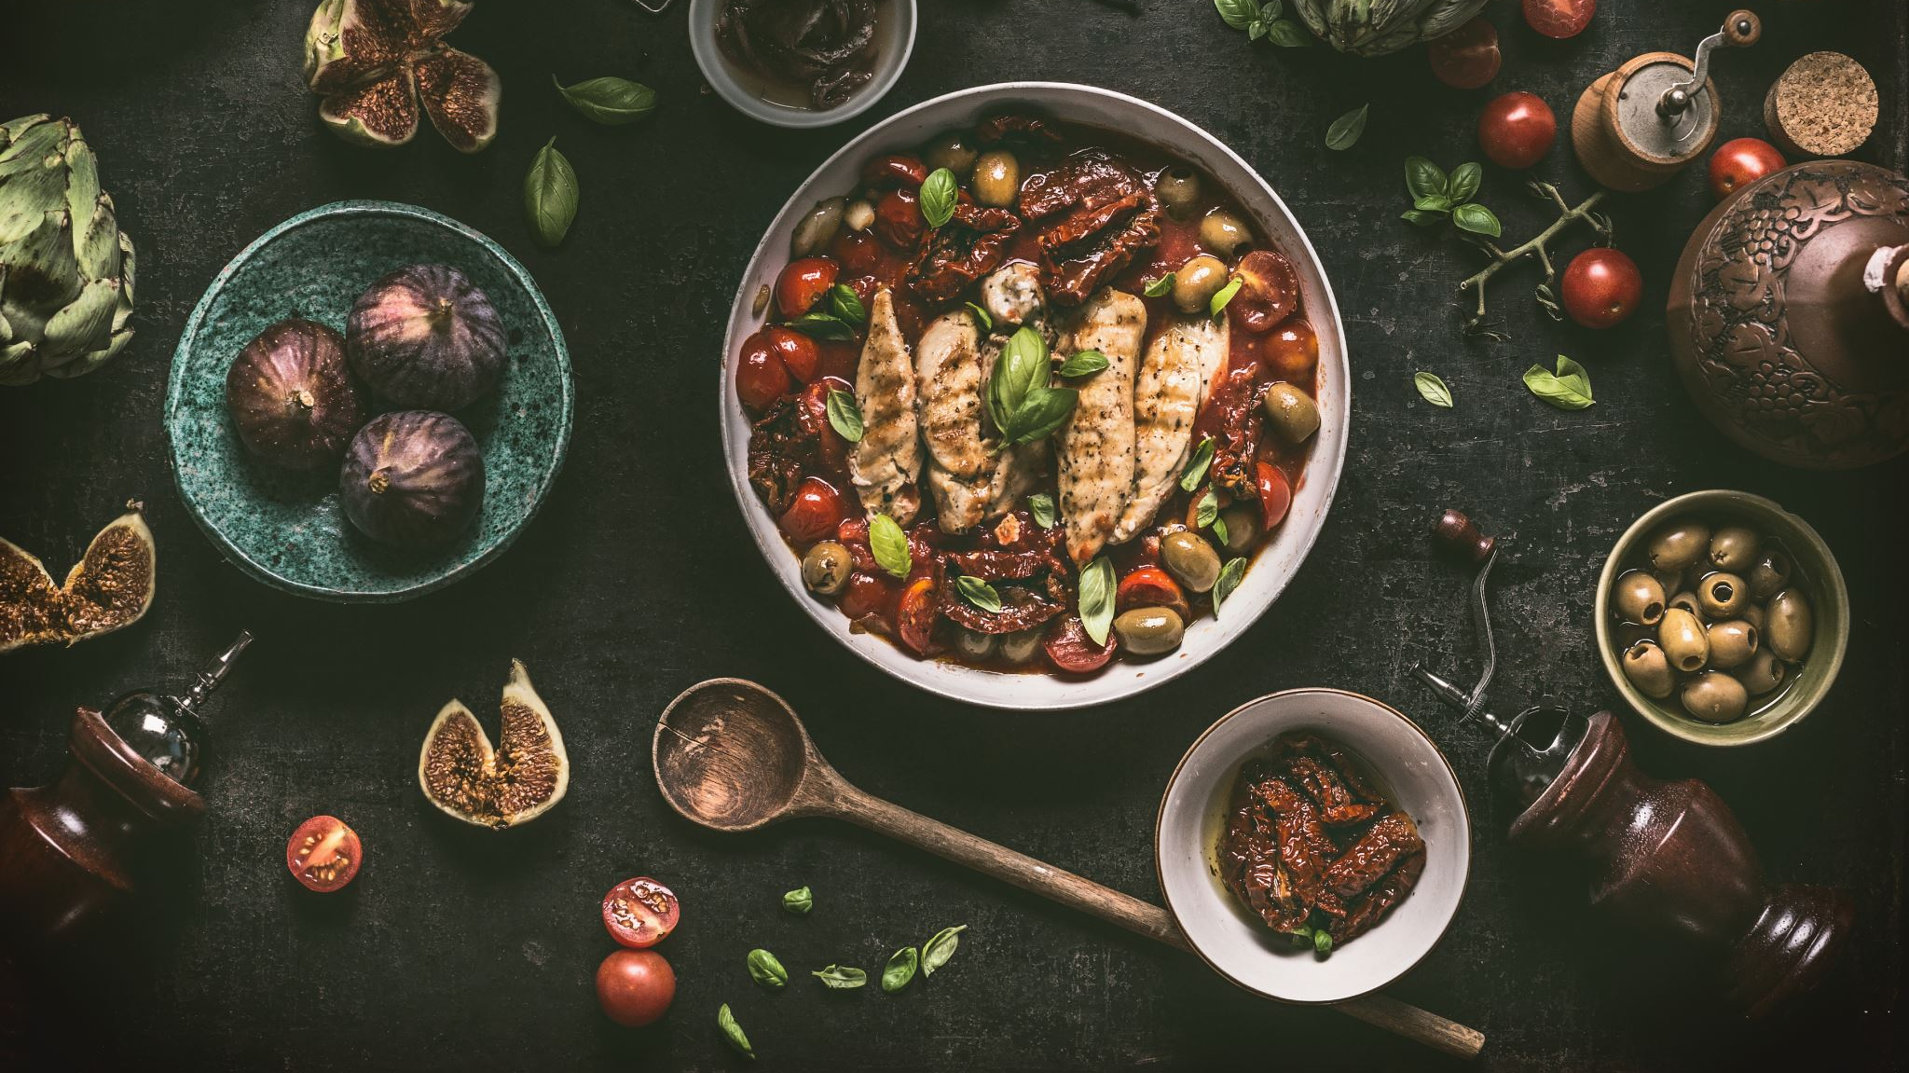
Data Analysis on Zomato
By: G S KAUSHIK
GUIDE : Aakansha Gupta

Slide 2
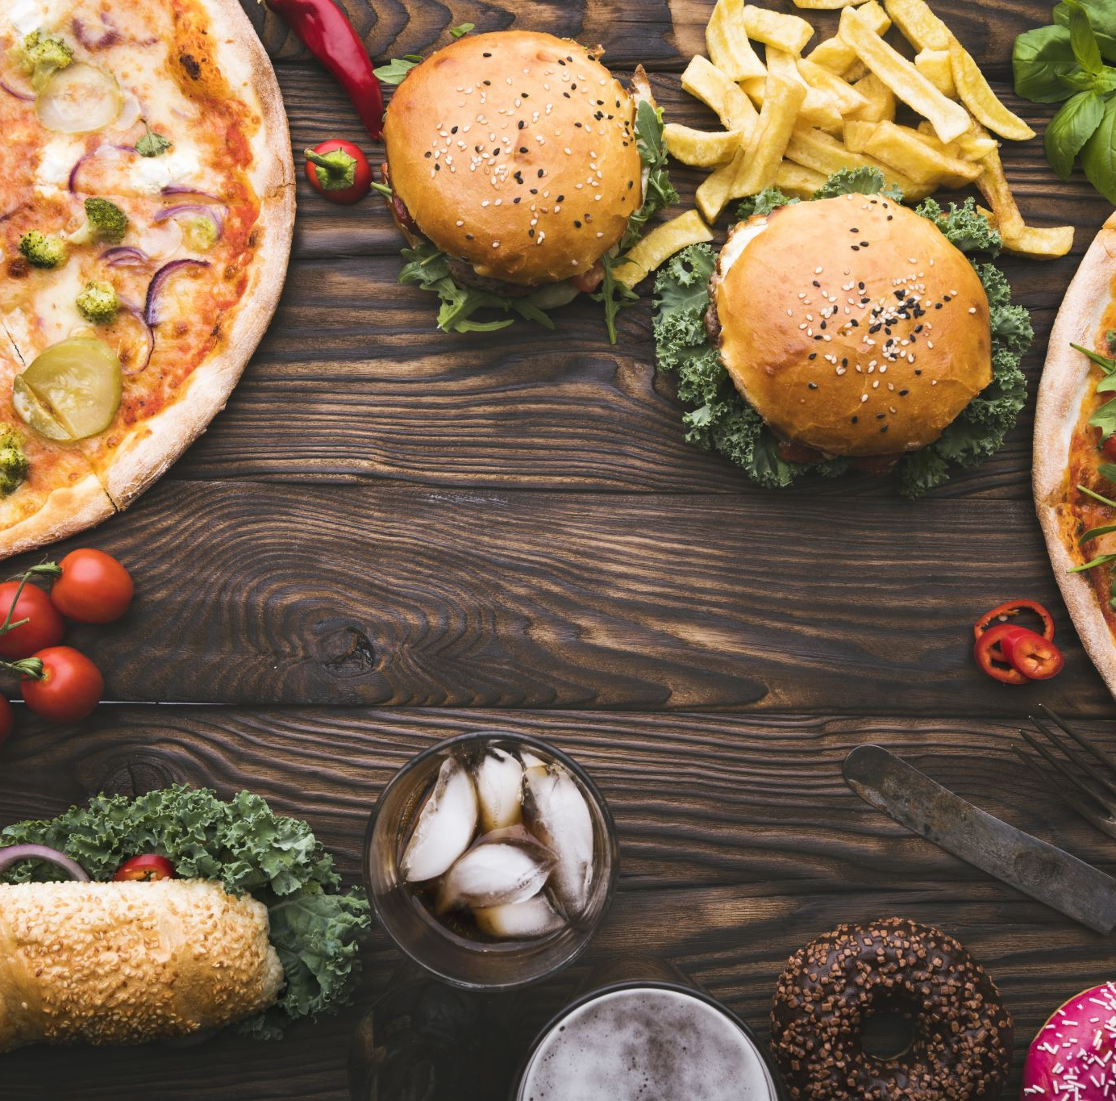
INTRODUCTION
Zomato is well known online food delivery app across India.
It's located in multiple cities and capital across states.
The objective of the data analysis is to help the people to choose best restaurant to have different kinds of cuisines in different location in Bengaluru city.

Slide 3

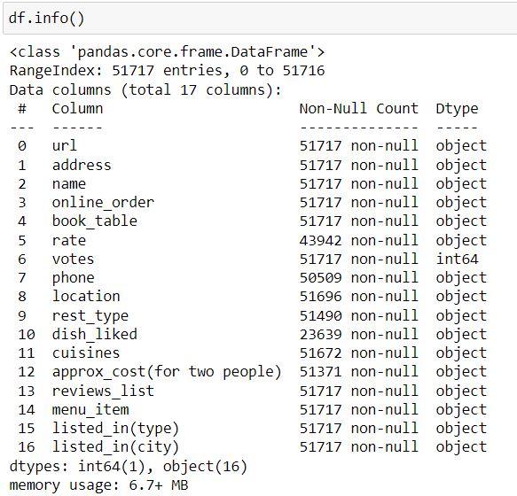
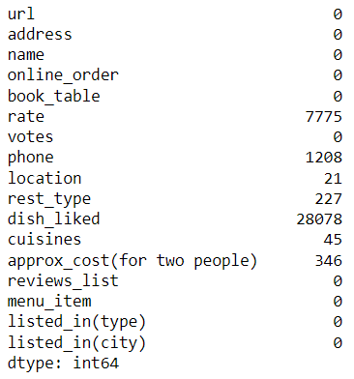
DATA DISCRIPTION
In the data set there are 17 features and 51717 rows.
There are null values in the multiple columns.
There are duplicate rows as well.
Columns like rate and approx. cost per 2 plate are in object data type which should be float type.

Slide 4
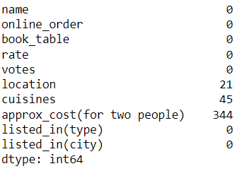
DATA TREATMENT
Dropped fewer contributing columns.
Dropped duplicate values from the rows.
Treated the values of rate and cost per 2 plate columns so that it can be converted to float data type.
Treated null value in categorical data to mode and numerical to mean.
Renamed columns which were not having appropriate names.
Segregated the columns into categorical and numerical type so that it can be used in EDA.
With univariant analysis found outliers in numerical data which are not errors so retained outliers.

Slide 5

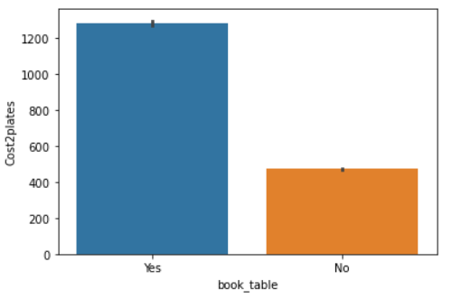
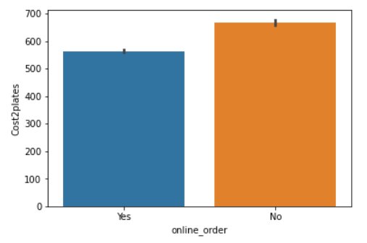
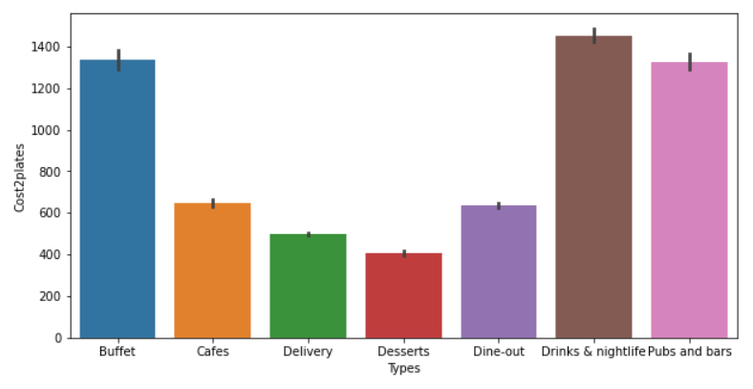
EDA
Online order is cheaper than dining out.
Booking table and eating out is costlier than taking parcel.
The cost of bars, buffets types are expensive.

Slide 6

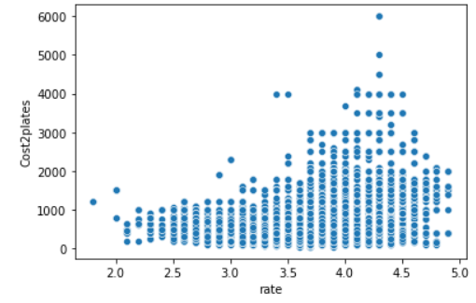
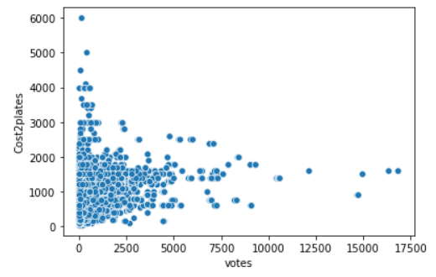
EDA
Most of the people voted high for Average cost of food.
People have given good reviews for the avg food cost since it satisfy all the condition of the people.

Slide 7

EXPORTING
Exporting clean data to csv format.
With help of excel further cleaned the cuisine features so there will be unique cuisine in each row of the data set.
Imported data to tableau for further analysis of the data.
Imported data to MYSQL for further insights of data.

Slide 8
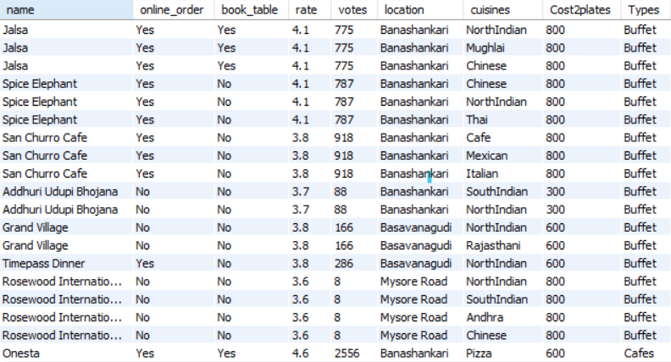
DISPLAYING ALL THE ROWS IN THE DATASET
There are 81471 rows and 9 columns. In final clean data set.

Slide 9
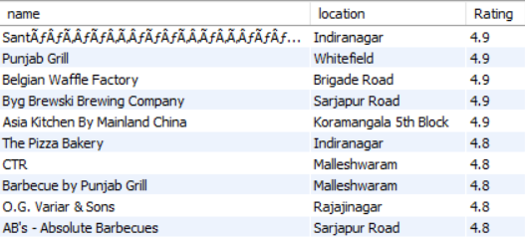
TOP 10 RESTAURANT BASED ON RATINGS AND THEIR LOCATION
Santafa in Indiranagar, Punjab Grill in Whitefield , Belgium Waffle Factory in Brigade road, Byg company in Sarjapur road, Asia Kitchen in Koramangala are the top restaurants in Bengaluru city. With rating of 4.9 in Zomato app.

Slide 10
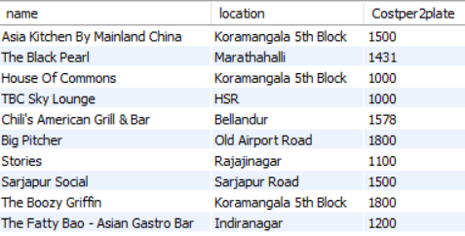
TOP 10 PUBS IN BENGALURU AND THIER AVERAGE PRICE PER PLATE
The table talk about the best pubs in Bengaluru.
House of Commons in Koramangala and TBC Sky lounge in HSR provide best combination of high rating and less average cost per 2 plate.

Slide 11
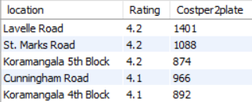
TOP 5 LOCATION BASED ON CUSTOMERS FOOD RATINGS AND TOTAL NUMBER OF RESTAURANTS PRESENT
Lavelle Road and St. Marks Road provide best quality of food.
Koramangala provide best food as well as the cost per 2 plate is also cheapest. So, it gives best combination of both rating as well as the cost.

Slide 12
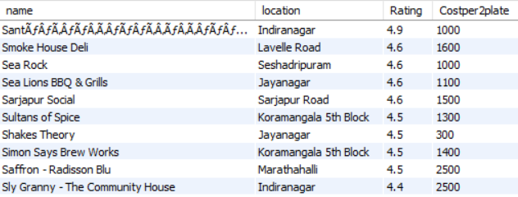

POPULAR RESTURENTS NAME SARTING WITH S AND THEIR AVG COST PER 2 PLATE AND THEIR LOCATION
Santaf in Indiranagar provide best food as well as the cost per plate is optimal.
Shake Theory in Jayanagar is cheapest among this list.

Slide 13
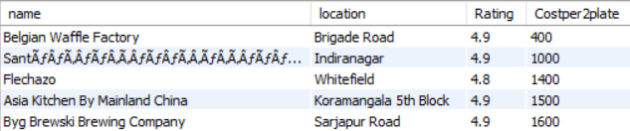
RESTAURANT WITH HIGH RATING AND LESS COST PER 2 PLATE
Belgium Waffle in Brigade road and Santaf in Indiranagar are having best combination of both rating as well as cost per 2 plate.

Slide 14
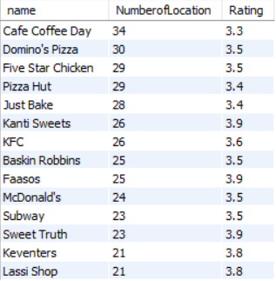
RESTAURANTS CHAINS BASED ON MORE THEN 10 LOCATION IN BENGALURU
There are total 14 restaurants having outlets more then 10 across Bengaluru.
Café Coffee day has the highest outlets.
Lassi shop and Keventers are the least.
Kanti sweets, Faasos and sweet Truth and average best rating among the chain of restaurants.

Slide 15
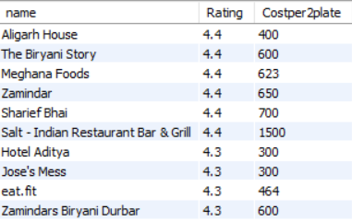
RESTAURANT OFFERING BIRIYANI AS CAUSINES WITH AFFORDABLE PRICE
In 4.4 rating Aligarh House provide best biriyani with less cost per 2 plates.
With 4.3 rating Hotel Aditya and jose’s Mess provide best biriyani with less cost per 2 plates.

Slide 16
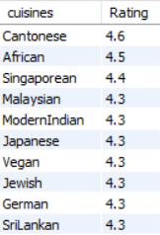
TOP CUISINES LIKED BY CUSTOMERS
Cantonese is most preferred cuisines by the people of Bengaluru.
Second most popular cuisines liked by Bengalurean is African cuisines.

Slide 17
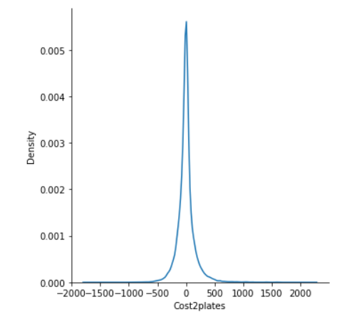
MACHINE LEARNING
Performance Check | Linear Regression | Decision Tree | Random Forest | Stacking
R Score Train | 0.47 | 0.95 | 0.89 | 0.94
R Score Test | 0.48 | 0.86 | 0.85 | 0.88
RMSE | 346.06 | 177.00 | 181.39 | 160.88
MAE | 242.48 | 89.65 | 113.75 | 96.08
MAPE | 0.5 | 0.23 | 0.26 | 0.23
Stacking regression is predicting best values, by taking bias and variance in account.
When the graph is plotted against the residual error it giving normal distribution. It determents that model is performing good

Slide 18
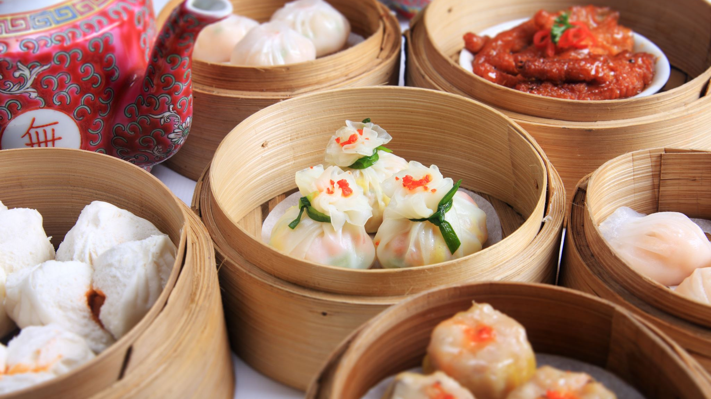
CONCLUSION
Indiranagar is best place to party during weekends since the price per plate is not high as well as the rating good.
People in Bengaluru are from all the parts of India, There is common taste that every people like is Chinese food, so Cantonese is the most preferred cuisines in Bengaluru.
To order food home Aligarh House Biriyani is preferred as it has good balance between rating as well as the price.
Koramangala is best place for the foodies to live as it has good rating as well as the price per plate.

Slide 19

THANK YOU

